Slide 1

STOCK MARKET TREND PREDICTIONS AND ANALYSIS USING DEEP LEARNING MODELS AND VISUAL REPRESENTATION
SANCHITA SURYAVANSHI - 18BCE0506
KAREN PINTO – 18BCE0596

Slide 2
ABSTRACT
Most of the daily stock market traders lose their money due lack of expertise and understanding of the movement of the market, so through this project we want to bring awareness to the people who are new and not well versed with trading on the stock market as most of the traders lack experience.
And it is impossible to keep track of the performance of stocks and shares in the market every hour, every minute and every second most traders lose money.
Predicting stocks has been an old age problem which is yet to be resolved. Few of the prediction systems were implemented but the problem of stocking up the data, updating data based on time periods became a challenging task.
Hence, we are planning to solve this old age issue by implementing various deep learning models and comparing them to determine which algorithm would suit perfectly according to the situation.

Slide 3
INTRODUCTION
We have come up with a solution for ordinary traders who understand market movements and predict positive results for sure. In this case we will develop a systematic approach using existing solutions where people having minimum knowledge in this field can do investments by seeing the graphs and visualizations .
This project will use deep learning models to predict the future outcomes of the stock market, by analysing and finding the pattern in the data set provided. The model will be composed of four functions which will be evaluating several different tasks and will have separate complexity according to their use cases.
Algorithms such as LSTM, Basic RNN (Vanilla RNN), and GRU along with their bi-directional algorithms will be the ones that would be used for prediction of stocks in the market.
Along with various deep learning models, a few more agents which are stock market trading strategies will also be used to help investors to predict stock trend and help to develop stock market investment strategies. Monte Carlo and Joint Plot Visualisation are used to depict the performances of various stocks and to help people understand which stock to invest in by studying graphs and visualizations.

Slide 4

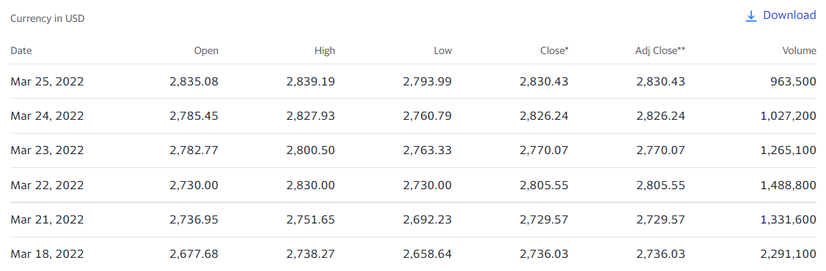
DATASET TO BE USED
YAHOO Finance

Slide 5
OBJECTIVES
Our project is working on the principles of macroeconomics and also on some parameters of Deep Learning, some commonly used terminology will be used in our project which is used in stock market.
The project will consist of a mix of three models which are :
1) RNN
2) GRU & BI-DIRECTIONAL GRU
3) LSTM & BI-DIRECTIONAL LSTM
The comparison of accuracy of these models will tell us which is suitable for the given dataset.
The aim of this project is to use agents which will help users to predict stock trends and guide user by notifying when to sell and buy a particular stock.
Sentiment analysis is used to understand financial news and make decisions on stock market investments.
To make it easier for a layman to understand this project also has data visualisation models like Monte Carlo Simulation and Joint Plot Visualisation.

Slide 6
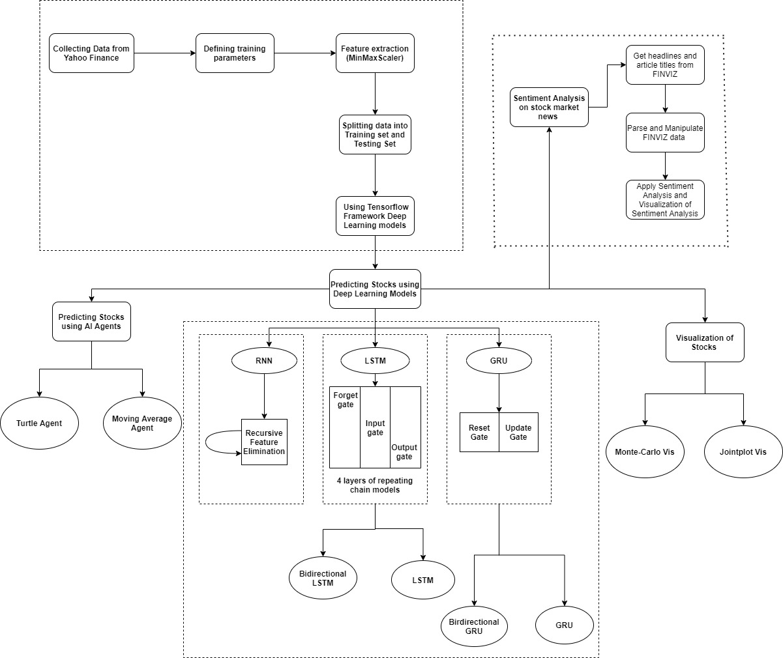
ARCHITECTURE
DIAGRAM

Slide 7

ALGORITHMS THAT WILL BE COMPARED AND ANALYSED
RNN
LSTM & BIDIRECTIONAL LSTM
GRU & BIDIRECTIONAL GRU

Slide 8
PREPARING THE TRAINING AND TARGET VALUES
x = 60 days (1-60)
y = target = 61st day’s Closing price
x = 60 days (2-61)
y = target = 62nd day’s Closing price
x = 60 days (3-62)
y = target = 63rd day’s Closing price
x = 60 days (4-63)
y = target = 64th day’s Closing price
x = 60 days (5-64)
y = target = 65th day’s Closing price
x = 60 days (6-65)
y = target = 66th day’s Closing price

Slide 9
 | Open | High | Low | Close | Volume
1 | … | … | … | … | …
2 | … | … | … | … | …
…….
60 | … | … | … | … | …
61 | … | … | … | Y | …
= X1 as a 2-D Array
= X2
= X60
Day 1 | Day 2 | …… | Day 60 | Target
X1 | X2 | …… | X60 | Y = 61st Day Closing Index
X2 | X3 | …… | X61 | Y = 62nd Day Closing Index
Training Inputs
Target Value

Slide 10
ACCURACY
Two types of accuracy/error computational formulas were used. Both are solely based on the mathematical distance of the predicted value from its real value.
Mean Absolute Percentage Error (MAPE)
Accuracy = (1 - np.mean(np.abs((real-predict)/real))) * 100
Root Mean Squared Error (RMSE)
Accuracy = (1 - np.sqrt(np.mean(np.square((real-predict)/real)))) * 100

Slide 11
SENTIMENT ANALYSIS
Sentiment analysis looks at the emotion expressed in a text. It is commonly used to analyze customer feedback, survey responses, and product reviews.
Sentiment analysis is used to determine whether a given text contains negative, positive, or neutral emotions. It’s a form of text analytics that uses natural language processing (NLP) and machine learning. Sentiment analysis is also known as “opinion mining” or “emotion artificial intelligence”.
A key aspect of sentiment analysis is polarity classification. Polarity refers to the overall sentiment conveyed by a particular text, phrase or word. This polarity can be expressed as a numerical rating known as a “sentiment score”.
Analyzing sentiment helps to evaluate the emotion's impact in a textual context for positive decision analysis.
In the stock market, the analysis of market sentiment is valuable as it can determine the opinions of investors regarding certain stocks or assets. The market sentiment and its influence is a clear representation of the impact of trading psychology.

Slide 12
ROADMAP
Review 2
Review 3
Visualization
Sentiment
Analysis
Agents
The simulations will help see all the possible outcomes, to understand the pattern and assess the impact of risk for better decision making.
Deep Learning Models
These agents will help investors to be able to buy or sell 1 unit per transaction.
Comparing various algorithms to find the best suited one for predicting future stocks
Process of detecting positive or negative sentiments in news articles.

Slide 13
CONTRIBUTIONS
We will be using extensive feature engineering.
We have used two different methods for predicting the stock trend namely deep learning models and we developed agents based on stock market trading strategies.
A customised long-short-term- memory (LSTM), Bi-directional LSTM, Basic RNN, Gated Recurrent Units (GRU) and Bi-directional GRU based deep learning models and their comparison based on the accuracy.
We will be using agents (Turtle trading agent and Moving average agent ) to depict selling and buying points of stock trend.
And we will be using Monte Carlo and joint Plot Visualisation techniques to represent the stocks.
We also included sentiment analysis in our project to make the trend accurate and so that all factors and outliers are included at the time of prediction.

Slide 14
CONCLUSION
The main idea of this project is to make a prediction model which could help people trade in the stock market despite being proficient in the stock market.
We all know the stock market is a risky game and models or algorithms are not 100% correct every time but with the help of this project are trying to implement a model as accurate as possible keeping the current trend in mind.
We will also show a visual comparison of various stocks on the basis of which a person will be able to take calls regarding buying and selling of a particular stock.
To identify this pattern we have used Markov Chain Models particularly Monte Carlo Simulations which searches for a pattern in the data set and makes predictions on the basis of it
Then with the help of deep learning we could make understanding stock market workload easy for analysts and even for customers who want to start trading by investing in stocks despite little knowledge.
Sentiment analysis is used to understand financial news and make decisions on stock market investments.

Slide 15

THANK YOU
SANCHITA SURYAVANSHI
18BCE0506
KAREN PINTO
18BCE0596

